Slide 1
The Battle of the Neighborhoods – Houston, Texas
Diego González Cárdenas
August/26/2020

Slide 2
A complete guide to find your new home at Houston
Houston, Texas is one of the most important cities in the US.
Privileged location
Vast amount of culinary, sports and entertainment venues
Top class Medical and educational services
Every single person has his/her own interests and elements of relevance when trying to find a place to live.
Once moving to a new city, state or country, it is important to move into the best neighborhood that one can find and afford

Slide 3
What would you find in this presentation?
Together we will try to find the best neighborhoods for your future apartment or house taking in consideration the following characteristics:
Proximity to attractive venues such as restaurants, bars, cafes and museums
Proximity to public transportation services
Proximity to hospitals/health care services
Proximity to education services/schools (Universities will be the point of interest)

Slide 4
Data for research
Venues - obtained from Foursquare location data service.
Venues around the indicated location in Houston (29.7589382, -95.3676974.)
Data will be grouped by categories
Public transportation
METRORail Service in Houston
Relevant presence all throughout Houston (3 rail lines and 44 Stations)
Most important transportation service in Houston
2 more rail lines to be added in the near future

Slide 5
Data for research (continued)
Hospitals - 2019 DSHS/AHA/THA Annual Survey of Hospitals
Most important hospitals in Houston
The latitude and longitude coordinates of the hospitals according to their address
Universities - https://www.unipage.net/en/universities/houston
List of universities of Houston
Latitude and longitude coordinates according to address

Slide 6
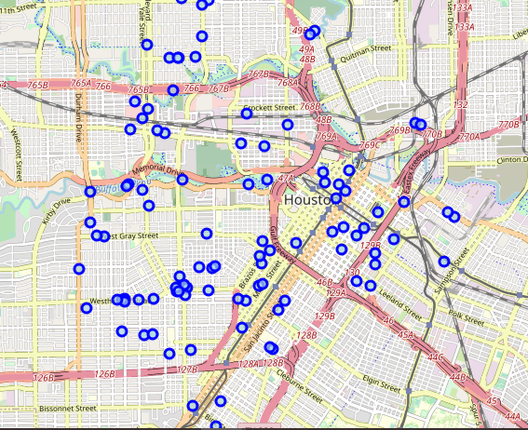
Important pressence of Venues in Houston
No matter what area of Houston you decide to live in, you will always have something fun to do, close to home

Slide 7
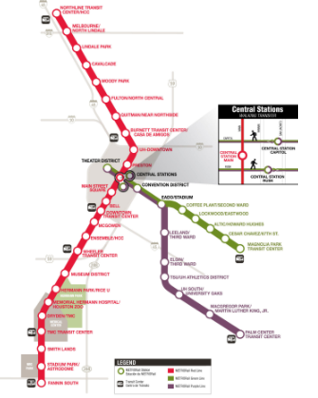
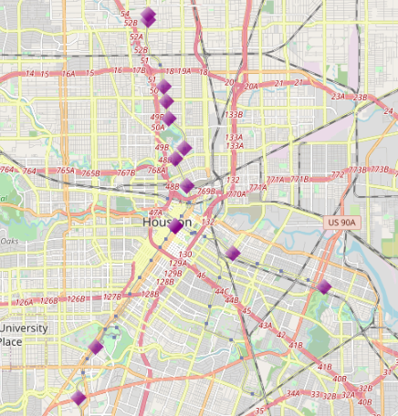
METRORail Stations
You’ll find quality in the public transportation Service everywhere
Vast amount of stations
https://www.ridemetro.org/Pages/Rail.aspx/posted/2491/METRORail_SystemMap1_27_2010.468583.pdf

Slide 8
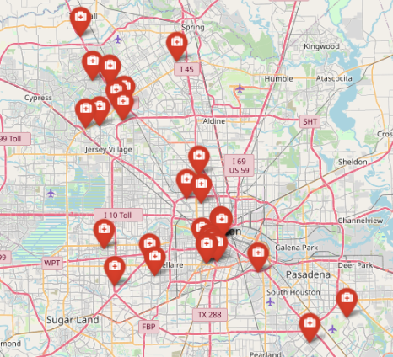
Hospitals in Houston
Abundancy of hospitals, scattered al throughout Houston
Important cluster on Downtown Houston

Slide 9
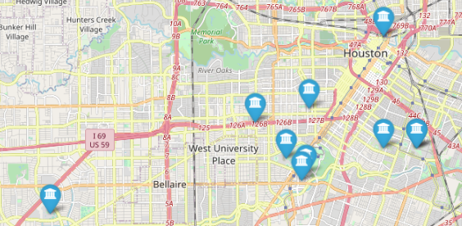
Universities
Abundancy of top class universities
Easy access

Slide 10
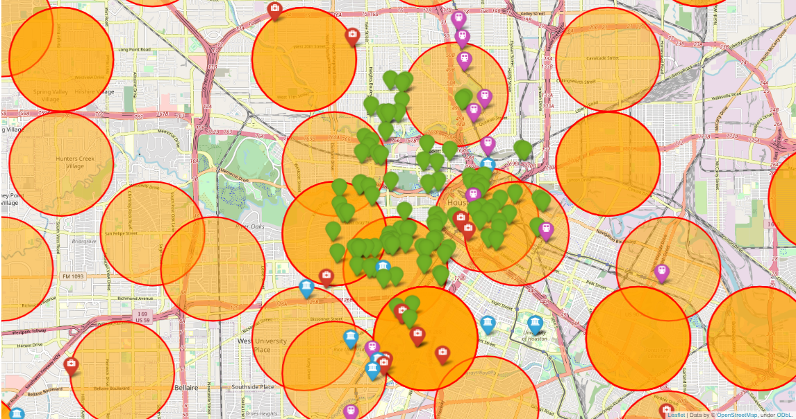




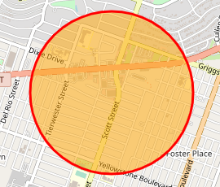
Putting all the pieces together
Venues
METRORail Stations
Hospitals
Universities
Neighborhood

Slide 11
Observations
Important presence of venues all throughout Houston
METRORail stations are distributed in a way that no matter where you live, the proximity to Hospitals will never be an issue in the city
important frequency of neighborhoods which include both Hospitals and Universities

Slide 12
Recommendations
My recommendation would be to live near Downtown Houston, nevertheless to avoid living in such neighborhood.
Live either on Neartown - Montrose or MacGregor neighborhoods.
They both have all the attractive features which we desire
The cost to living in such neighborhoods will be somewhat lower than living on Downtown Houston, plus being less overcrowded.

Slide 13
Project Improvement Opportunities
Change the way we retrieve venues locations
First get the location of all the neighborhoods and do a venue search for all the neighborhood center locations.
More accurate distribution of venues.
Presence of venues all throughout the map rather than only on the center.
Use GEO JSON to get a more accurate neighborhood location and shape
Compliment with a database of apartment prices to involve the Cost of living factor as well

